Slide 1
Unity WebGL snake game project
Ѓорѓи Галевски, 196041
Спасе Костадински, 196116

Slide 2
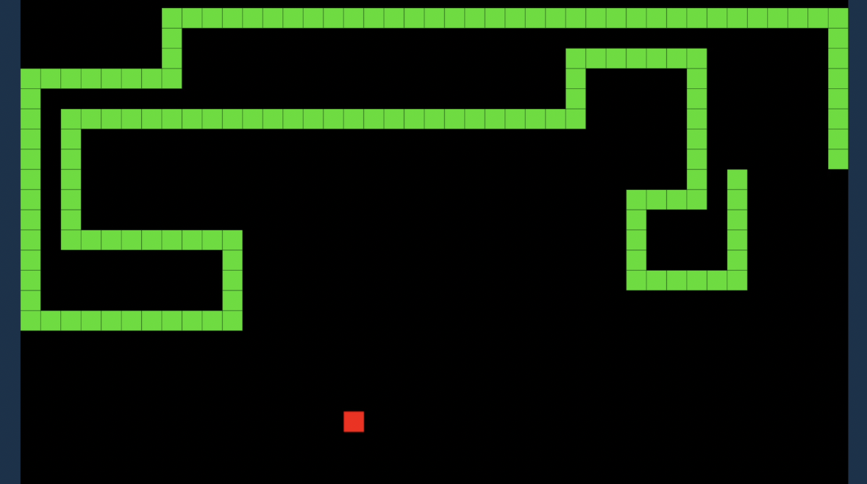
Introduction
Main goals
Objectives
Snake game and it's history

Slide 3
Project goal
Develep a functional Snake game with classic gameplay
Implement scoring mechanics and high score tracking
Explore the Unity WebGL platform for web deployment

Slide 4
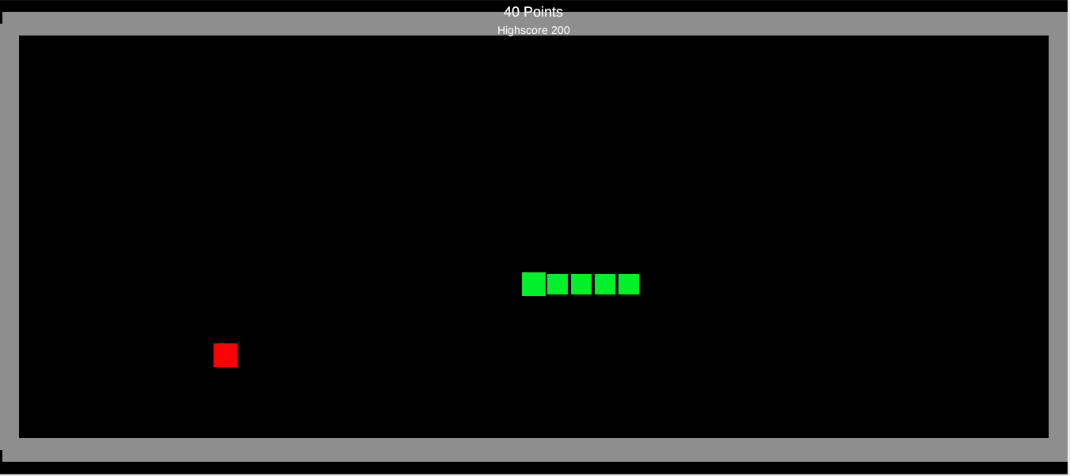
Game overview
Key features of the Snake game
Design choices made for the game
Importance of scoring and high score tracking

Slide 5
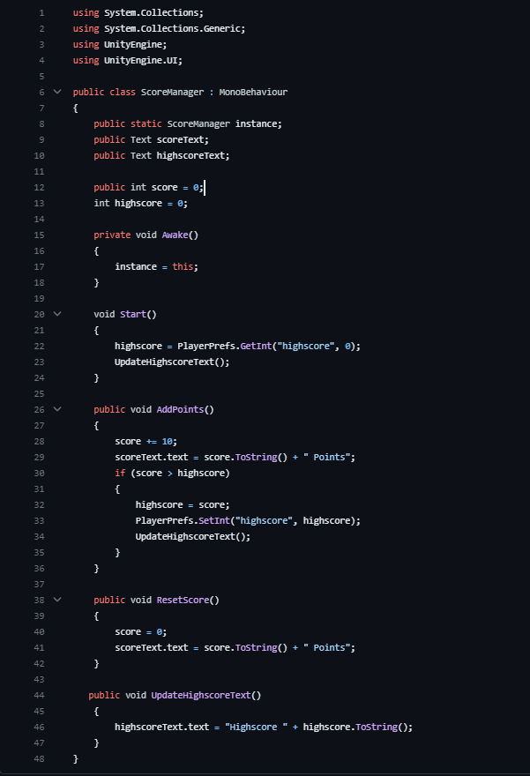
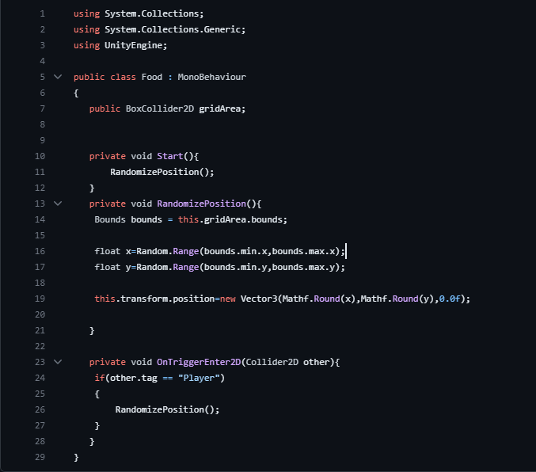
Technical implementation

Slide 6
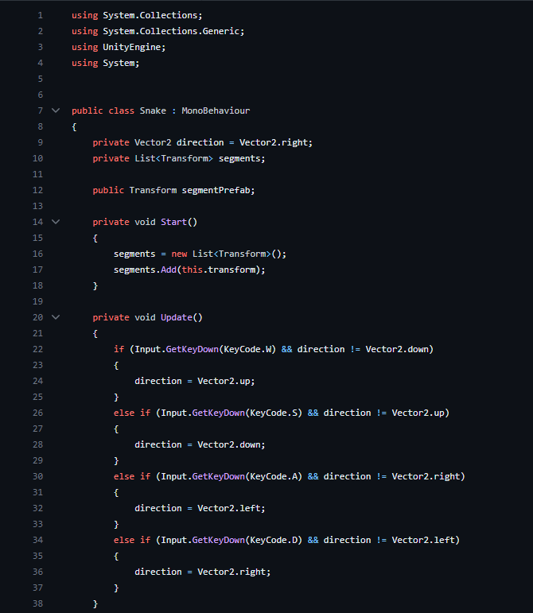
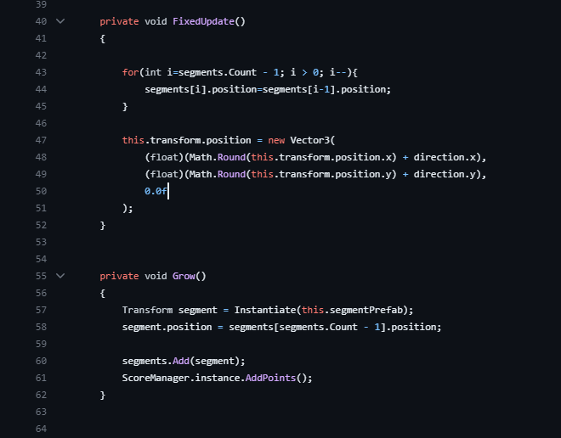
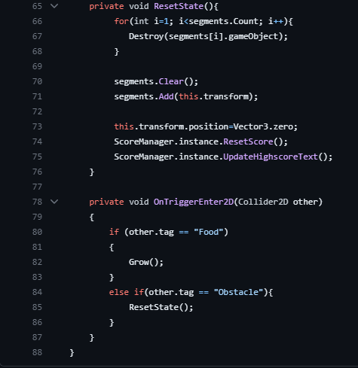
Technical implementation

Slide 7
Challenges and solutions
Challenges faced during deployment
Online Hosting
Version control for collaboration

Slide 8
Future Development
Scoreboard Leaderboard
Difficulty levels
Level mode

Slide 9
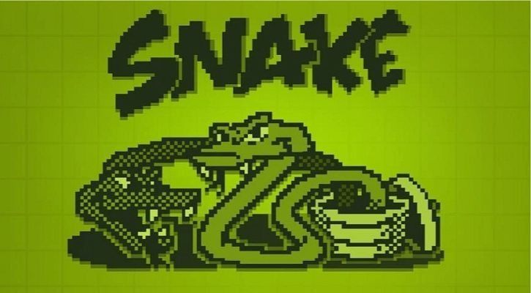
CONCLUSION

